Slide 1
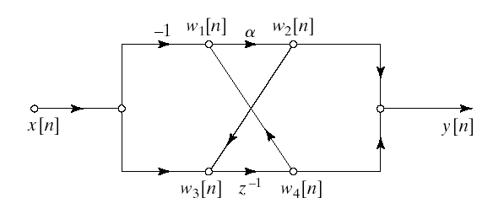
Determination of System Function from Flow Graph

Slide 2
Determination of System Function from Flow Graph

Slide 3
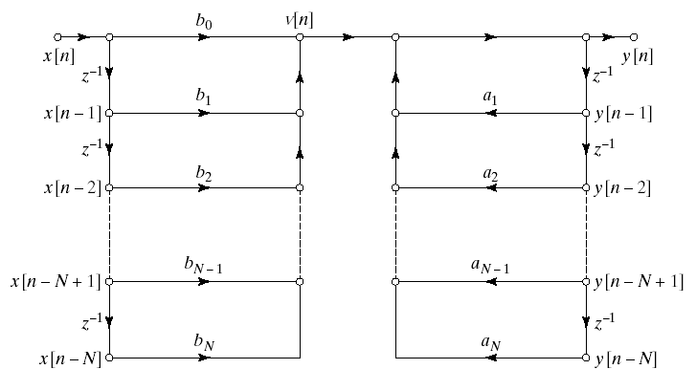
Direct Form-1
General form (Direct)

Slide 4
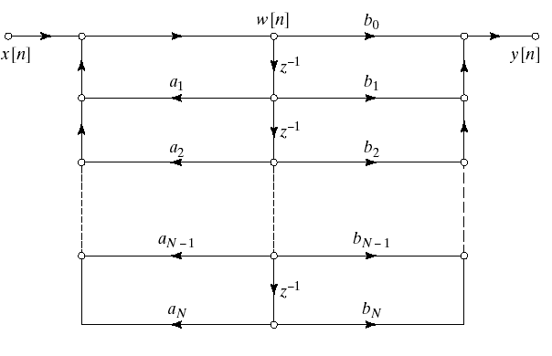
Direct Form-2
General form (Direct)

Slide 5
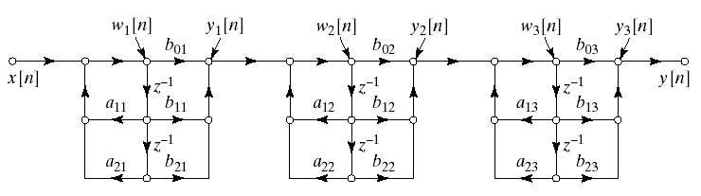
Basic Structures for IIR Systems: Cascade Form
General form (Direct)
More practical form in 2nd order systems

Slide 6
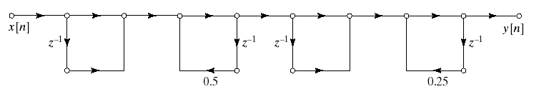
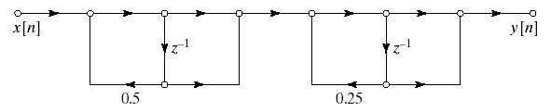
Example
Cascade of Direct Form I subsections
Cascade of Direct Form II subsections

Slide 7
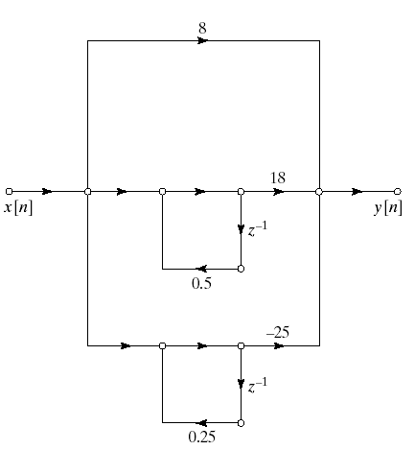
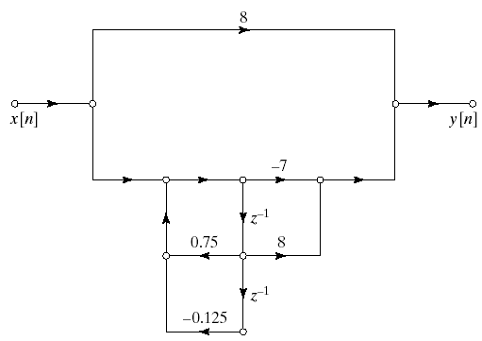
Basic Structures for IIR Systems: Parallel Form (Example)
Partial Fraction Expansion
Combine poles to get

Slide 8
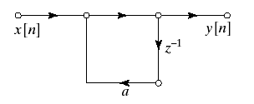
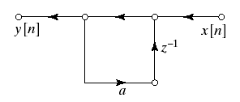
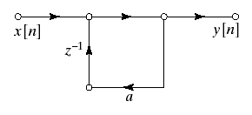
Transposed Forms
Linear signal flow graph property:
Transposing doesn’t change the input-output relation
Transposing:
Reverse directions of all branches
Interchange input and output nodes
Example:
Reverse directions of branches and interchange input and output

